Slide 1
Dealing with Covid, coping with Lockdown and Recovery
People with Learning Disabilities in the Pandemic
Vicky Green, Surviving through Story

Slide 2
About this presentation
Information about people with learning disabilities and COVID
Lockdown - how it has hit us
How the pandemic affected us, our family and friends
Coming to terms and coping
How Covid is spreading
Dealing with grief
Vaccines and how we cope
Recovery - coming back to normal

Slide 3
Recovery - getting back to normal.

Slide 4
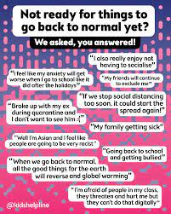
Recovery - getting back to normal October 2021
How can we get things back to normal ?
The truth is that we don’t know we are going to get back to normal as the infection rate is still very high and we aren’t sure how things are going to end up.
What are your experiences?
Let’s discuss

